Slide 1

Analysis of Grocery Trends and Data in US Under an Economic Lens
William Torrey
(Computer Science)
Brendan McCormack
(Electrical Engineering)
Michael Lesse
(Computer Science)
April 4th 2026

Slide 2
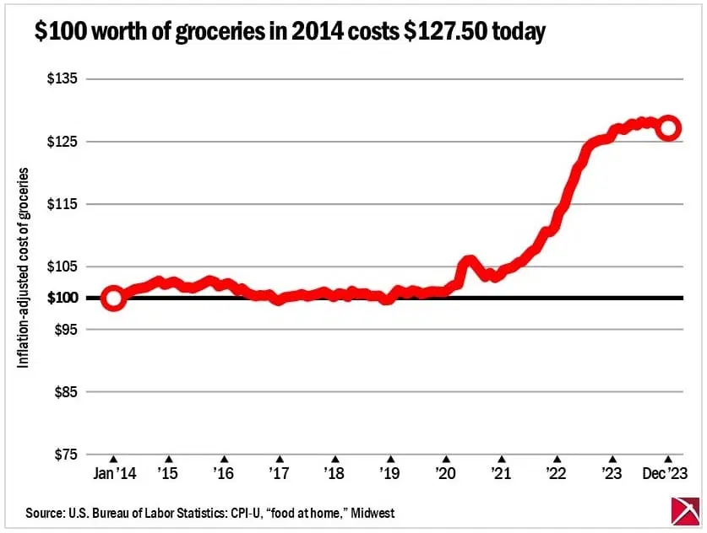
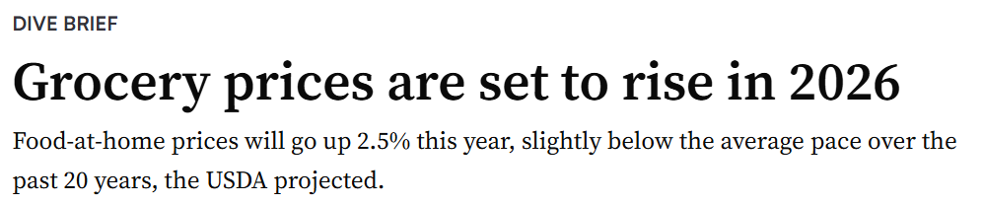
Background & Problem Statement
Recent national, economic, and political attention has been granted to the cost of groceries its rising prices.
It is however open to mounds of misinformation or loss of data due to involvement in the political scene.
As many college students may have limited knowledge of the trends of grocery prices, it is important to better parse this information to understand how worried they should be.
Dips and bubbles are very common in the economic cycle so understanding irregulatites or unnatural trends of upward or downward data is important.

Slide 3

Data Sources (& Justification)
CPI_food_at_home
From US Department of Agriculture
Sourced from federal government
Contains Annual % changes in food CPI indexes from 1974-2024
nominal_expenditures_no_taxes_tips
From US Department of Agriculture
Sourced from the federal government so can be considered reasonably reliable
Contains food purchasing information for ~30 years
Median_hourly_private_employees
From US Bureau of Labor Statistics, retrieved from FRED
Contains average hourly earning of private employees on gross basis
Moderate-cost_monthly_food_plans
From US Department of Agriculture
based on food prices, composition data, consumption patterns, etc
Contains historical moderate cost monthly food plans
USDA_monthly_food_plan (FMAP)
From US Department of Agriculture
Sourced from federal government
Represent moderate, nutritious diets, that are prepared at home, with varying sizes of families
USDA FOOD ATLAS
-From the US Department of Agriculture Economic Research Service Sourced
-Represents county-level food environment data across all 3,143 US counties, covering prices, access, health, and food insecurity from 2008 to 2016

Slide 4
Raw Data Example & Analysis
Measured in millions of nominal U.S. Dollars
Year | Food sales at grocery stores | Total food-at-home expenditures | Total food-away-from-home expenditures | Total alcohol-at-home sales | Total alcohol-away-from-home sales
1997 | 263,215.10 | 355,583.16 | 303,119.44 | 47,911.67 | 34,763.56
1998 | 266,097.60 | 363,860.59 | 319,008.53 | 49,461.40 | 37,301.27
2016 | 406,567.80 | 734,842.52 | 810,380.20 | 100,430.47 | 84,123.12
2017 | 419,534.90 | 763,413.12 | 864,863.19 | 106,478.48 | 88,372.93
2018 | 432,253.40 | 786,526.51 | 904,514.47 | 110,609.94 | 92,396.96
2019 | 449,350.10 | 807,333.34 | 944,644.28 | 112,369.57 | 96,268.72
2020 | 497,636.90 | 865,277.51 | 832,214.82 | 120,383.68 | 68,842.05
2021 | 519,413.80 | 919,975.85 | 1,020,836.81 | 130,502.10 | 99,264.79
2022 | 562,032.90 | 993,676.45 | 1,164,918.86 | 138,460.17 | 116,822.46
2023 | 576,053.70 | 1,013,992.57 | 1,275,145.05 | 138,829.64 | 131,731.01
2024 | 589,907.90 | 1,037,498.92 | 1,337,887.64 | 140,715.68 | 140,100.74

Slide 5
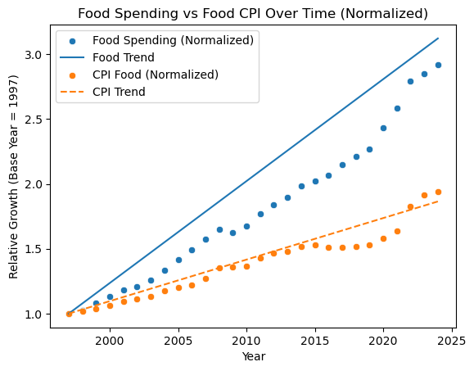
How has the price of groceries increased in comparison to inflation over the years?
Inflation is a natural aspect to the economic flow of the nation and world so it is not a implicit worry when inflation is seen in the food purchasing industry.
It is important to determine is if the growth of grocery prices is consistent with inflation or if the price is outpacing it.
While both show upward trends, the increase in grocery spending drastically exceeds what the changes that inflation dictate it should.

Slide 6
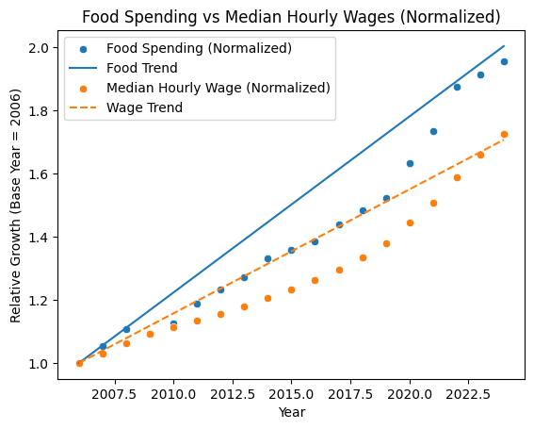
How has the price of groceries increased in comparison to wages over the years?
Due to the close relationship that inflation and wages have, it is not only important to know if the cost of groceries is raising correctly in tandem with inflation, but that those designed to purchase them are able to do so without serious blows to budgeting
While the increase in average wages in the private sectors do seem to trend higher than inflation, it is still outpaced by the cost of food, showing that the effect inflation has is more impactful.
average wage growth of $17.32 total from 2006 to 2026

Slide 7
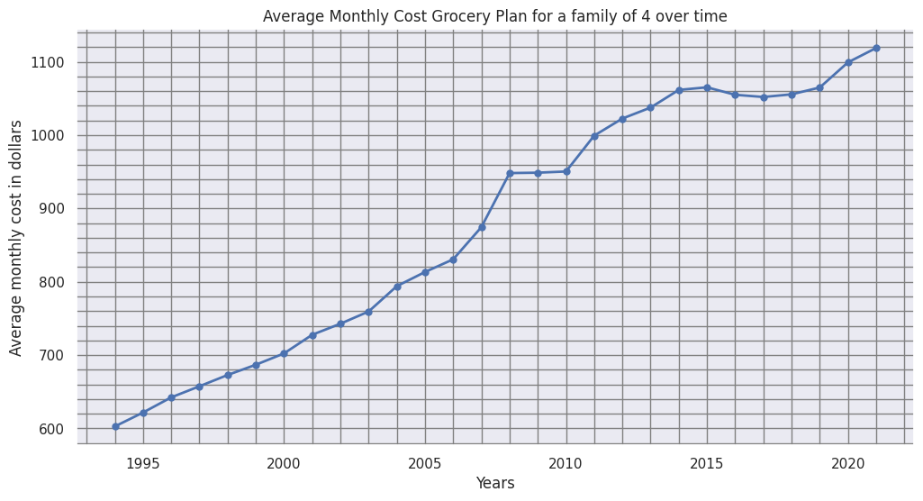
How has the cost of groceries for a family of 4 changed over the years?
The US national average of people in a household was determined to be 3.13 -> rounded up to 4.
It is important to look at the average and standard household when working with this information as it can help differentiate corner cases from what the trend changes say about the changing industry as a whole
This series shows a clear long term trend in cost. We saw groceries increase by $229.39 per year (2.33%), resulting in a 85.63% change from 1994-2021

Slide 8
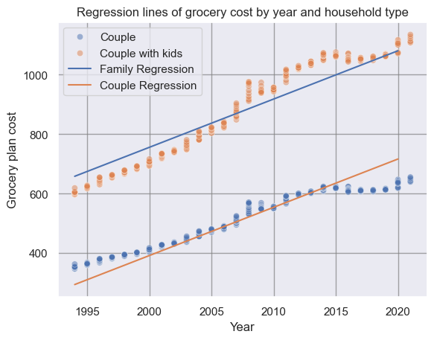
How do children in a household affect the cost of living grocery-wise over the years?
It is important to analyze how children in the household can associate with its grocery costs.
Both households show long term upward trends, but illustrate the clear cost-gap between children in the household
This regression is on average off by about 49 dollars as per our root mse, but still illustrates the difference children make.
Children introduce ~$363 increase in a families household moderate grocery plan per month

Slide 9
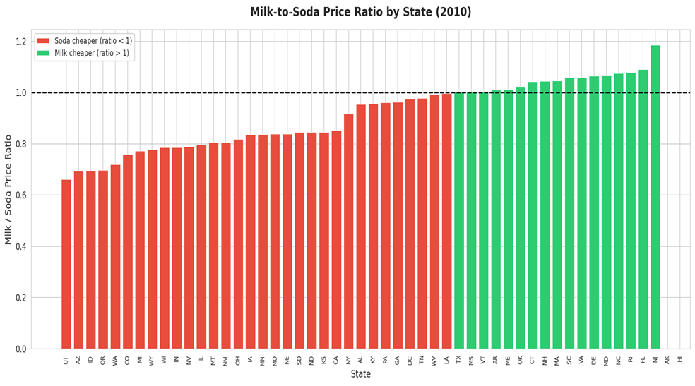
How has the price of healthy and unhealthy foods changed in juxtaposition with each other?
It often seems that the healthier options for food is always the more convenient choice, we hope to determine how large of a gap, if any, has been created economically to push people to take the less health option.
In nearly two thirds of all U.S. counties, soda is a cheaper option than water for sale. This pricing dynamic, often shaped by agricultural subsidies and distribution infrastructure has significant implications for pushing predetermined dietary choices, particularly in lower income communities where cost is a primary driver of food selection.
Metric | Value
Counties where soda was cheaper than milk | 2,050 (65%)
Counties where milk was cheaper than soda | 1,059 (34%)
National average milk price (2010) | $0.99 / unit
National average soda price (2010) | $1.00 / unit
Average milk-to-soda ratio (by state) | 0.91

Slide 10

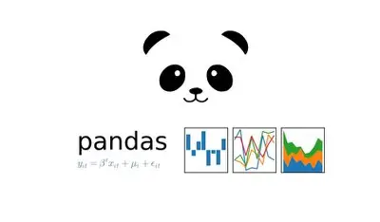
APIs and Libraries Used
Pandas (pd)
A data analysis library that provides DataFrame and Series structures for organizing, cleaning, and manipulating structured datasets.
Seaborn (sns)
A visualization library built on Matplotlib that specializes in statistical graphics and simplifies the creation of structured, informative plots.
Numpy (np)
A numerical computing library that supports array-based operations, linear algebra, and efficient mathematical computations.
Matplotlib (mpl)
A plotting library that provides the underlying framework for generating a wide range of static and interactive visualizations.
Matplotlib.pyplot (plt)
A module within Matplotlib that offers a procedural interface for creating and modifying plots through sequential commands.

Slide 11
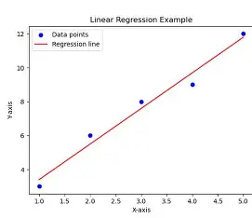
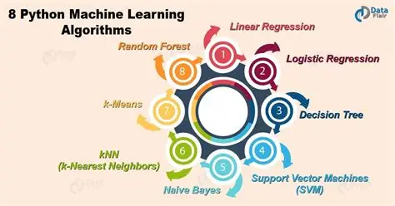
Tools and Materials Used
Heavy involvement and use of Linear Regression for both Wage and Inflation question analysis.
Regression and training proves to remain effective in showing general trends of data and allowing for further analysis
Trends of food costs, inflation, and wages provide slight skewed influence on regression model as seen in the surge of prices and inflation around and after the 2020 pandemic.

Slide 12
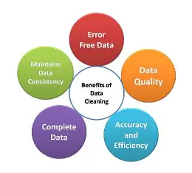

Data Cleaning and Engineered Features
We performed many standard cleaning techniques to prepare our sets for analysis including: Munigng and feature engineering
Particularly for our food plan data, the time frame we were searching for was split across 3 separate sets, and required reformatting in order to concatenate them together
We also often engineered date features across sets to fit across consistent timespans. The inflation data needed to be renamed and thinned out across a smaller range to fit with other data, while the wage data needed to be merged and averaged as the data was monthly and not yearly like the data being compared to.

Slide 13
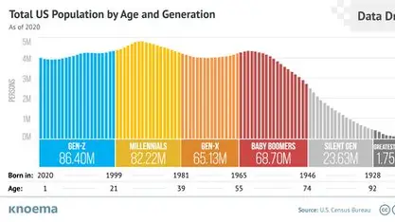
Conclusion & Future Research
Our data consistently supports and gives credence to the conclusion that the growth of costs for foodstuffs is grossly outpacing that of the wages or past means of accessing it. With each member of a household leading to drastic increases in the monetary investment needed, it does lead to more economic disincentive for younger individuals to start families or have children.
Further research of our own will be done to see how the changing trends of birth rates or statistics on the younger generation’s household development and creation supports this conclusion on costs acting as a decision point for creating families.

Slide 14
Thank you!
Any Questions?
April 3rd 2026

Slide 15
Citations Slide
User Guide — pandas 3.0.2 documentation
seaborn: statistical data visualization — seaborn 0.13.2 documentation
NumPy
Matplotlib — Visualization with Python
Pyplot tutorial — Matplotlib 3.10.8 documentation
Food Expenditure Series | Economic Research Service
Grocery Prices Tracker
Family spending workbook 1: detailed expenditure and trends - Office for National Statistics
Downloadable Data | USDA FoodData Central
Employed full time: Median usual weekly real earnings: Wage and salary workers: 16 years and over (LES1252881600Q) | FRED
USDA Food Plans: Monthly Cost of Food Reports | Food and Nutrition Service

